Slide 1

COMM223 Marketing Management
Lecture 6 – Product I

Slide 2
Midterm
Open-book, 1.5 hours exam during class time on Feb 21st
On Moodle
45 Multiple choice questions
Includes lectures 1,2,3,4,5 and 6

Slide 3
Agenda
Product
product
Three levels of product
Types of consumer product
Product and service decisions
Individual product decisions
Product line decisions
Product mix decisions
Service marketing
Branding strategy
Brand equity and brand value
Building strong brands

Slide 4
Where are we now …
Company
Company Analysis
Competitor Analysis
Consumer Analysis
Marketing Management
Competitor
Consumer
Product
Promotion
Price
Distribution
Product - Market

Slide 5
What Is a Product?
A product is anything that can be offered to a market for attention, acquisition, use, or consumption that might satisfy a need or want.
A service is a form of product that consists of activities, benefits or satisfactions offered for sale that are essentially intangible and do not result in the ownership of anything.
Companies create and manage customer experiences with their brands or companies.
To differentiate their offers from that of the competitors

Slide 6
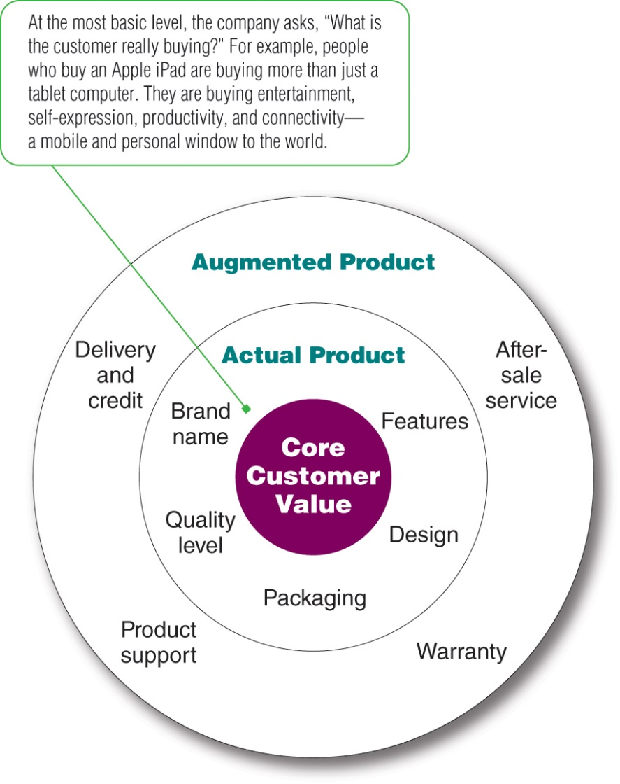
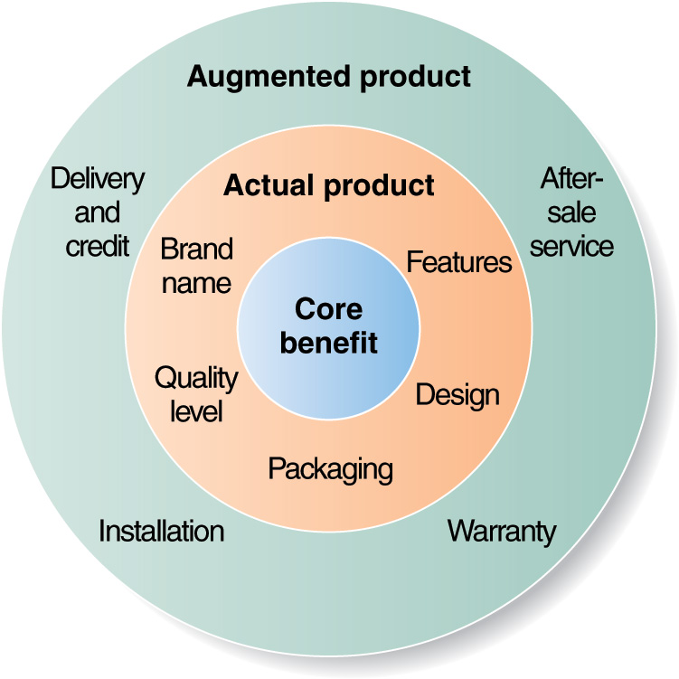
Three Levels of Product

Slide 7
Product and Service Classifications
Consumer products are bought by final consumers for personal consumption.
Industrial products are bought by individuals and organizations for further processing or for use in conducting a business.
Materials and parts, capital items, and supplies and services

Slide 8
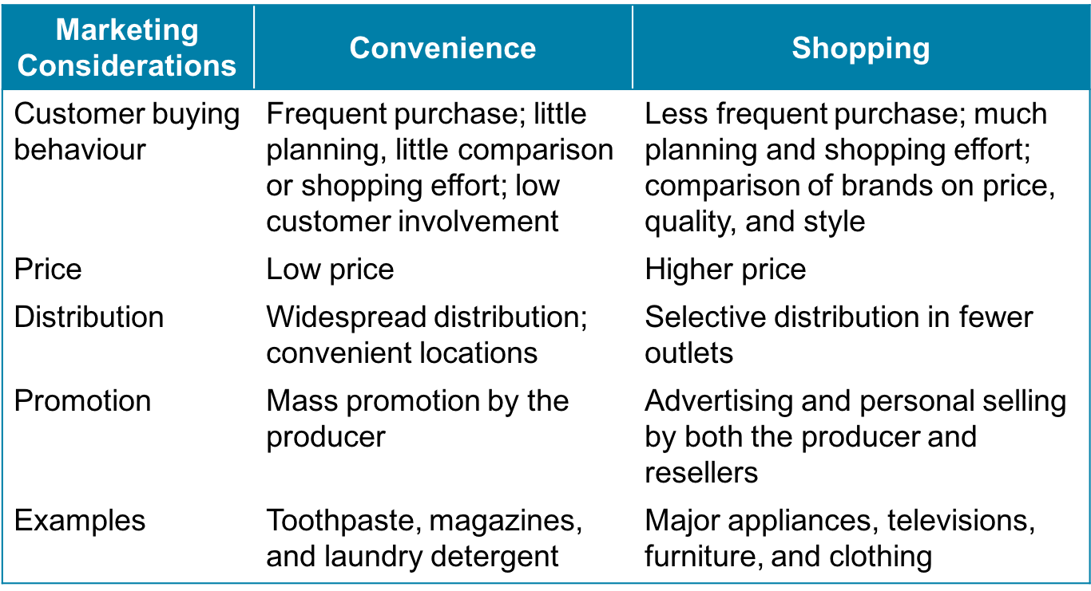
Consumer Products

Slide 9
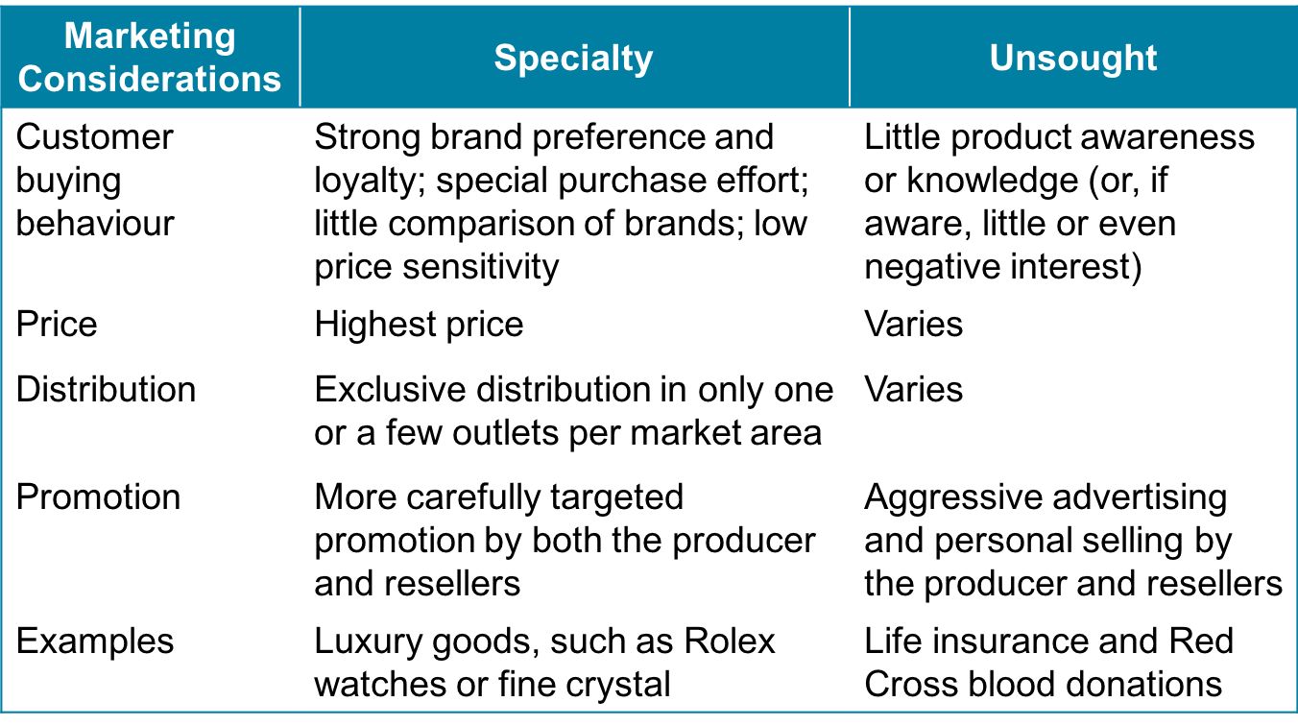
Consumer Products

Slide 10
Product and Service Decisions
Individual product and service decisions
Product line decisions
Product mix decisions

Slide 11
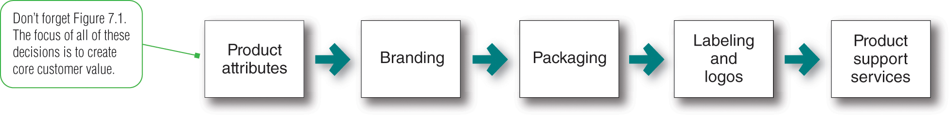
Product and Service Decisions Individual Product and Service Decisions

Slide 12
Product and Service Decisions Individual Product and Service Decisions
Product and Service Attributes
Quality
Lined to customer value and satisfaction
The whole company needs to be involved (TQM)全面质量管理
Features
Competitive tool for differentiating product
Should be valued by the customer as determined through market research
Style and Design
Good design contributes to product’s usefulness as well as looks

Slide 13
Product and Service Decisions Individual Product and Service Decisions
Branding
Brand: a name, term, sign, symbol, or design that identifies the product
Branding can add value to a product
Branding helps buyers
Identify products
Determine quality
Branding helps sellers
Convey product quality
Provide legal protection
Segment markets

Slide 14
Product and Service Decisions Individual Product and Service Decisions
Packaging
Often includes primary, secondary and shipping packages
Functions of packaging
Hold and protect
Promote the product
Differentiate the product

Slide 15
Product and Service Decisions Individual Product and Service Decisions
Labelling serves to identify the product
Describes the product
Promotes the product
Must be careful not to:
Mislead customers
Fail to describe ingredients
Fail to include safety warnings

Slide 16
Product and Service Decisions Individual Product and Service Decisions
Product support services
Survey customers regularly to assess current customer service
Companies use a mix of phone, email, fax, Internet and interactive voice and data technologies

Slide 17
Product and Service Decisions Product Line Decisions
Product line
A group of products that are closely related because they …
function in a similar manner
are sold to the same customer groups
Are marketed through the same types of outlets
fall within given price ranges
Product line length
Line stretching: adding products that are higher or lower priced than the existing line
Line filling: adding more items within the present price range

Slide 18
Stretching Downward
Product Line Decisions
High
Present products
(high-end)
Price
New products
(low-end)
Facing a slow-growth and/or high competition
on its high-end positioning
Quality
e.g., DaimlerChrysler: Mercedes C-Class ($40,000) vs. other Mercedes ($130,000)
Rolex: Rolex Tudor ($1,750) vs.
Rolex Submariner ($5,000)
Low
Low
High

Slide 19
Stretching Upward
Product Line Decisions
High
New products
(high-end)
Price
Present products
(low-end)
To add prestige to their current product or be attracted by a faster growth rate or higher margins利润率 at the higher end
Quality
Low
e.g., Toyota – Lexus; Nissan – Infiniti, Honda - Acura
Low
High

Slide 20
Stretching Both Ways
Product Line Decisions
New Products
(high-end)
High
Price
Present products
New products
(low-end)
Quality
e.g., Marriott: Renaissance Hotels (higher) and TownePlace Suites (lower)
Low
Low
High

Slide 21
Product and Service Decisions Product Mix Decisions
Product Mix
Also known as product portfolio
Consists of all the product lines and items that a particular seller offers for sale
Width: # of product lines
Length: # of products in lines
Depth: # of versions of each product carried
Consistency: how closely related the product lines are

Slide 22
Graphically…
Product Line
Entire Product Assortment
Product
Category A
Product
Category B
Product
Category C
Product
Category D
Brand A
6oz
8oz
16oz
Brand B
Red
Blue
Brand C
Brand D
Regular
Large
Product Line Depth
Product line Width
Product Line Length

Slide 23
Services Marketing
Services
Account for 69% of Canada’s GDP, almost 75% of employment, and nearly 90% of new job creation.
Service industries include business organizations, government, and private not-for-profit organizations

Slide 24
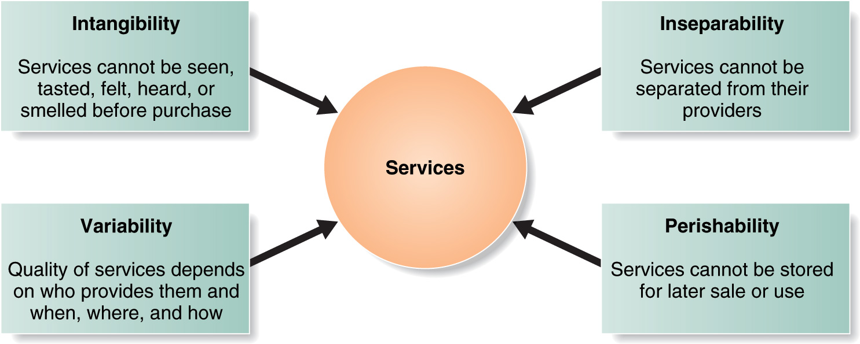
Four Service Characteristics

Slide 25
Service-Profit Chain
Satisfied & Productive Service Employees
Healthy Service Profits & Growth
Internal Service Quality
Greater Service Value
Satisfied & Loyal Customers
Company
Internal
marketing
External
marketing
Employees
Interactive
marketing
Customers

Slide 26
Marketing Tasks for Service Companies
Managing service differentiation
Developing a differentiated offer, delivery, and image
Managing service quality
Delivering consistently higher quality than the competitors
Managing service productivity
Training current employees or hiring new ones
Increasing the quantity of service by giving up some quality
Harnessing the power of technology

Slide 27
Branding Strategy
Brand equity is the positive differential effect that knowing the brand name has on customer response to the product or service
One measure of equity is the extent to which customers are willing to pay more for the brand客户愿意为品牌支付更多费用的程度
With positive brand equity, consumers react more favourably to the brand than to an unbranded version of the same product. 有了正的品牌资产，消费者对品牌的反应比对同一产品的无品牌版本更有利。

Slide 28
Branding Strategy
Brand value is the total financial value of a brand.
Customer equity is the value of customer relationships that the brand creates.
品牌价值是品牌的总财务价值。
客户资产是品牌创造的客户关系的价值。

Slide 29
Branding Strategy
Brands with strong equity have many competitive advantages:
High consumer awareness
Strong brand loyalty
Helps when introducing new products
Less susceptible to price competition不易受价格竞争的影响

Slide 30
Branding Strategy: Major Branding Decisions
Brand positioning
Attributes
Benefits
Beliefs and values
Brand name
selection
Selection
Protection
Manufacturer’s brand
Private brand
Licensed brand
Co-branding
Brand
sponsorship
Brand
Development
New brands
Line extensions
Brand extensions
Multibrands

Slide 31
Building Strong Strategy
Brand Positioning
Brand Name Selection
Brand Sponsorship
Brand Development
Three levels of positioning:
Product attributes
Least effective
Benefits
Beliefs and values
Taps into emotions

Slide 32
Building Strong Strategy
Brand Positioning
Brand Name Selection
Brand Sponsorship
Brand Development
Good Brand Names:
Suggest something about the product or its benefits
Are easy to pronounce, recognize and remember
Are distinctive
Are extendable
Translate well into other languages
Can be registered and legally protected

Slide 33
Building Strong Strategy
Brand Positioning
Brand Name Selection
Brand Sponsorship
Brand Development
Manufacturer brands
Private (store) brands
Costly to establish and promote
Higher profit margins
Licensed brands
Name and character licensing has grown
Co-branding
Advantages/ disadvantages

Slide 34
Building Strong Strategy
Brand Positioning
Brand Name Selection
Brand Sponsorship
Brand Development
Line extensions
Minor changes to existing products
Brand extensions
Successful brand names help introduce new products
Multibrands
Multiple product entries in a product category
New brands
New product category

Slide 35
Brand Development
Product Category
Existing
New
Line
extension
Brand
extension
Existing
Brand Name
Multibrands
New brands
New

Slide 36
Brand Development
Line extension:
Advantages:
low-cost, low-risk way to introduce new products
Meet customer desires for variety
utilize excess capacity
command more shelf space from resellers
Disadvantages:
lose its specific meaning
cause consumer confusion or frustration
sales of an extension may come at the expense of other items in the line (cannibalization).
Brand extension:
Advantages:
instant recognition and faster acceptance
saving the high advertising costs usually required to build a new brand name
Disadvantages:
May confuse the image of the main brand
If a brand extension fails, it may harm consumer attitudes toward the other products carrying the same brand name
A brand name may not be appropriate to a particular new product

Slide 37
Brand Development
Multibrands
Advantages:
establish different features and appeal to different buying motives
allow a company to lock up more reseller “shelf space”
Disadvantages:
each brand may obtain only a small market share, and none may be very profitable – marketing resources are limited!
New brands
Advantages:
No effect from existing bad brand
Disadvantages:
can result in a company spreading its resources too thin

Slide 38
Managing brands
Communicate the brand’s positioning
Manage all brand touch points
Train employees to be customer centered
Audit the brand’s strengths and weaknesses

Slide 39
Starbucks: Brewing a Worldwide experience
What is the core customer value that Starbucks offers? What are the actual and augmented level of that product?
Core customer value:

Slide 40
Starbucks
Actual product:
Augmented product:

Slide 41
Starbucks
How would you classify Starbucks product using the marketing considerations for a consumer product outlined in the chapter? What individual product decisions has Starbucks made?

Slide 42
Starbucks
Individual product decisions:
Product quality:
Product features:
Product style and design:
Packaging:

Slide 43
Starbucks
Is Starbucks’ a product or a service? How are the concepts of service marketing important to Starbucks?

Slide 44
Good luck on the midterm!

